Slide 1

Session 2- git intro and exercises
STARTING A GITHUB ACCOUNT AND FIRST REPOSITORY

Slide 2

GIT – WHAT IS IT, AND VERSION CONTROL
Git is a distributed version control system.
What is version control?
DevOps – Continuously plan build and release small improvements, continuous improvement, version control helps to track and manage and maintain a record of these small changes in a way that facilities working independently and across teams especially on applications that involve the development of code
Git is a language and software for managing versions of projects
Git is a distributed version because every user maintains an independent copy of the “repository” on their own machine.

Slide 3
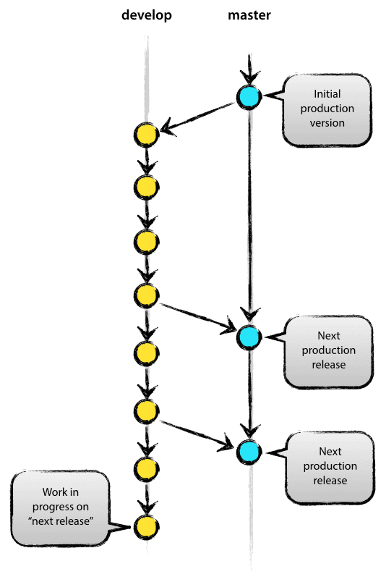
Git the basics
Stage (add), commit, pull, push, branch and merge.
Stage (choose files to save)
Commit (create a version and Save it locally)
Pull (bring changes from a remote repository to your local repository
Push (move a local commit to a remote repository)
Branch (create a new branch)
Merge (bring a commit from another branch into your target)

Slide 4
GitHub - https://github.com
One of the largest collections of repositories for open source code around.
Maker of software for version control used by many, many businesses with code or statistical software as part of their work-flow.
Free to use and create public and private repositories of code (or other items) for sharing and collaboration
Provides a workflow for teamwork, and reproducible research as well as a secure cloud backup for your code and reporting.
Github desktop is a tool for managing your code repositories locally and linking them to the github website.

Slide 5
A couple of helpful youtube videos: there are hundreds
What git is:
https://www.youtube.com/watch?v=fJtyf62yAb8
How to get started:
https://www.youtube.com/watch?v=GqNAD4XoZ6k

Slide 6
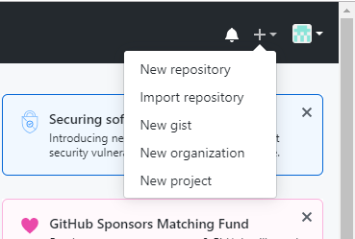
Exercise https://guides.github.com/activities/hello-world/
Steps for exercise
Navigate in a browser to https://github.com/
Click the signup tab in the upper right
Choose a username and password and proceed to create an account (this will require email verification)
Make sure to choose a no reply email option to keep your email private (unless you prefer to have this public).
Log in to your new account
Click to create a new repository

Slide 7
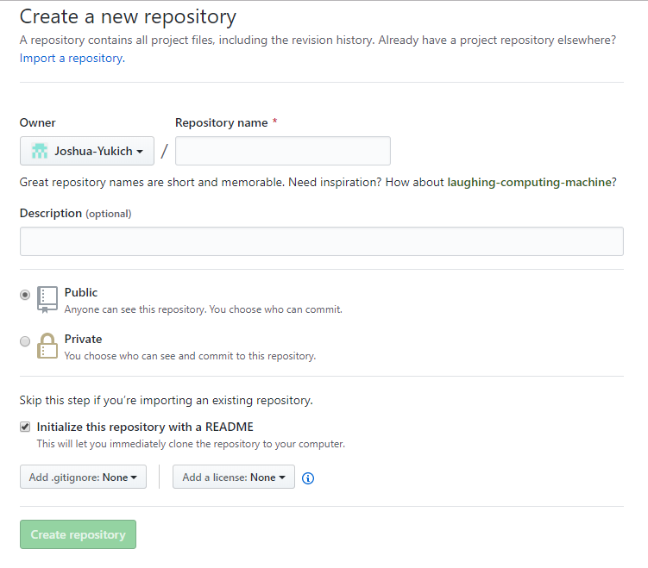
Exercise https://guides.github.com/activities/hello-world/
Name your repository
Write a short description
Choose public or private
And initialize with a README
For now skip .gitignore and license
Create repository

Slide 8
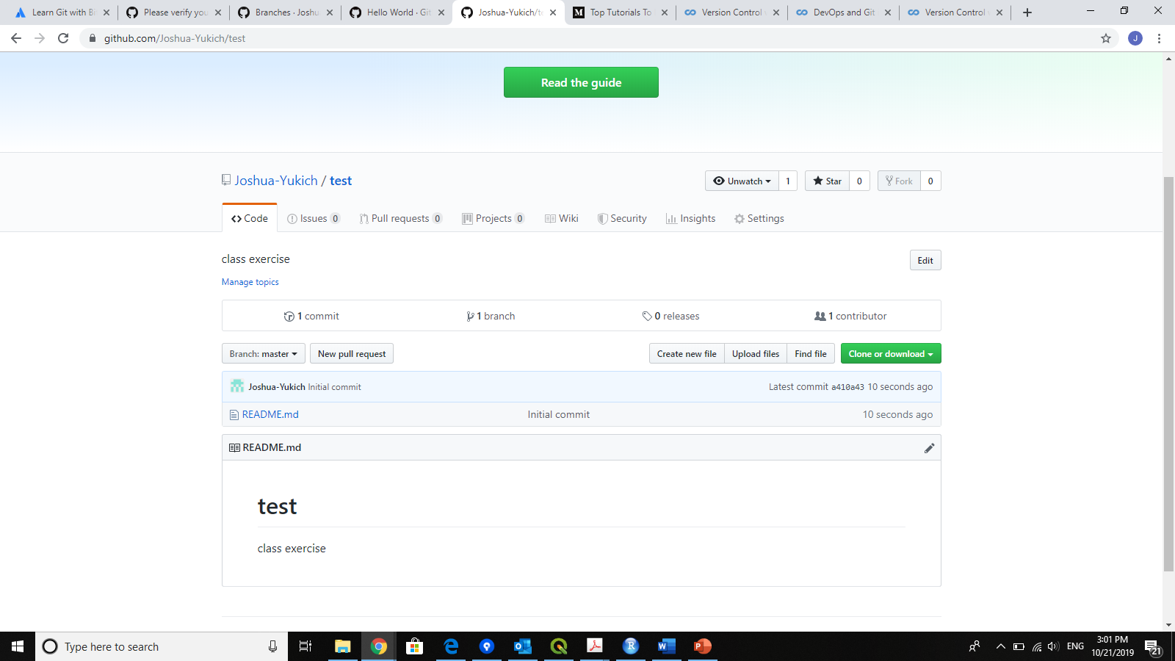
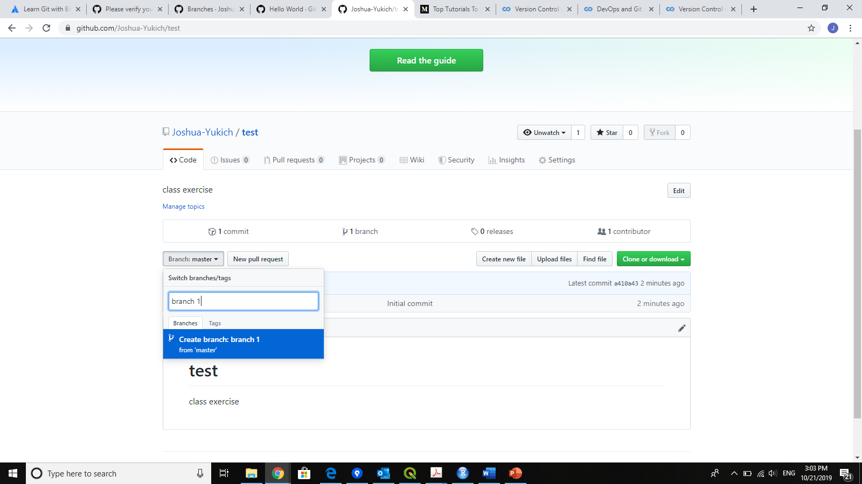
Exercise https://guides.github.com/activities/hello-world/
Create a new branch
Click on branch box, type name of new branch and click create

Slide 9
Exercise https://guides.github.com/activities/hello-world/
Create a new branch
Click on branch box, type name of new branch and click create

Slide 10
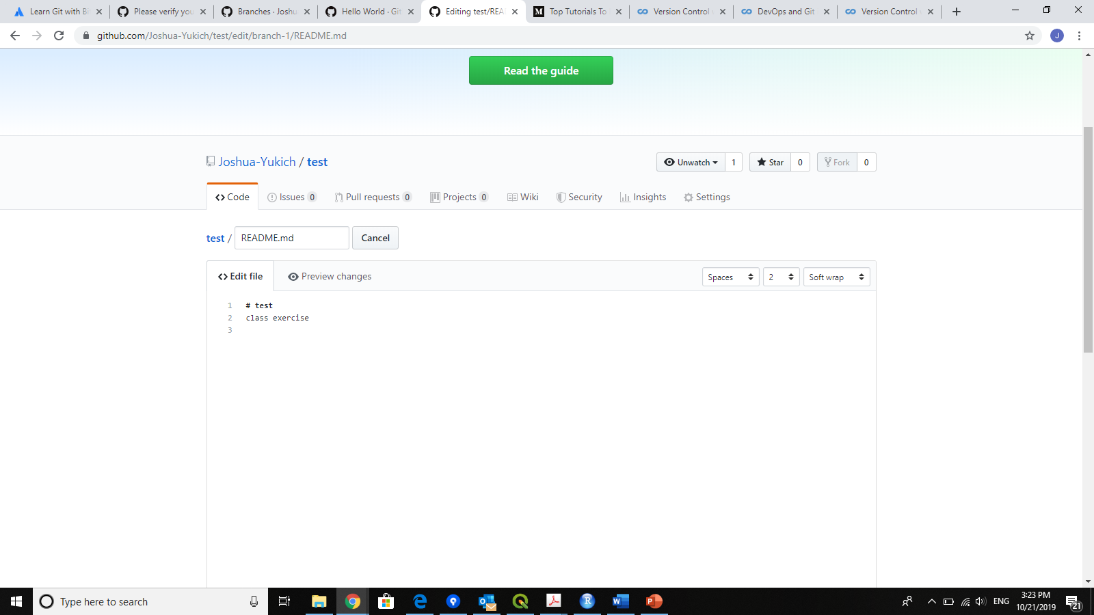
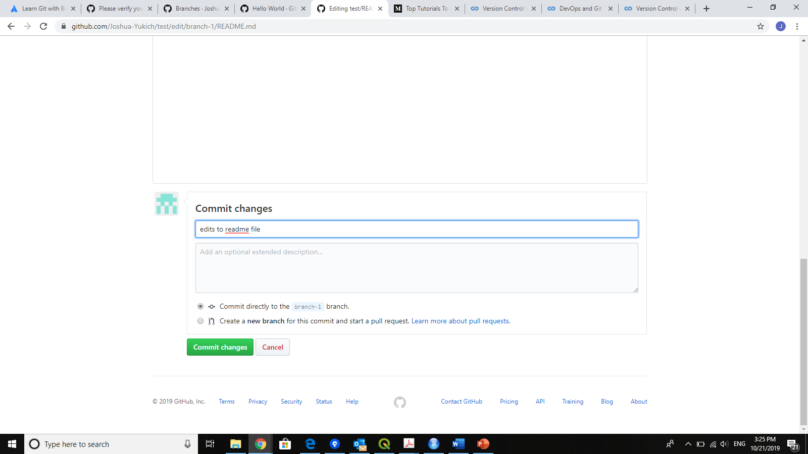
Exercise https://guides.github.com/activities/hello-world/
Edit the readme.md file
Scroll down and commit changes – must add description

Slide 11
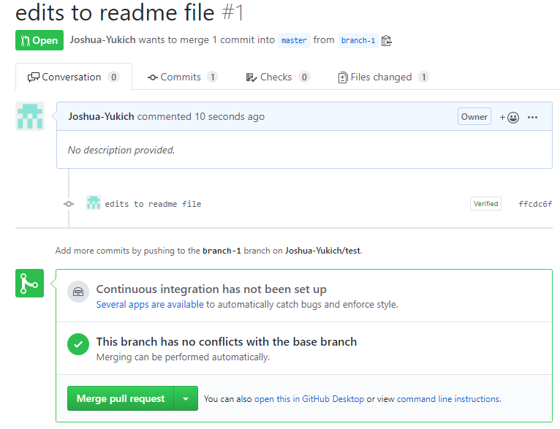
Exercise https://guides.github.com/activities/hello-world/
Create a Pull request
Switch to pull requests tab
Click create new pull request
Select to send changes from new branch to master
Click to create pull request
Click to merge pull request into master branch

